Slide 1
Tweet Text Extraction Based on Sentiment
CHENG, Lin, 20711693
LAU, Cho Han, 20729595
QIAO, Shuyu, 20747563
Notes:
Hello everyone. We are Cheng Lin, Lau Cho Han and Qiao Shuyu. Today, we’ll be presenting our project. The topic of our project is Tweet Text Extraction Based on Sentiment.

Slide 2
Table of Contents
Introduction
Data Description
Exploratory Data Analysis (EDA)
Methods & Models
Nltk
SpaCy
RoBERTa
Conclusion & Future Works
Notes:
We’ll cover the following sections in our presentation

Slide 3
Introduction
Notes:
Firstly, we’ll introduce our project.

Slide 4


Introduction
Extract keywords or key phrases to identify sentiment description
RoBERTa
Notes:
Twitter is one of the most popular SNS that people use nowadays. But it’s difficult to evaluate whether the sentiment of a sentence will have an impact or not. Evaluating the sentiment of sentences is therefore essential when making decisions.
However, we do not know which word is used for sentiment description. In general, the sentiment of a sentence can be classified as positive, negative, and neutral. Some words or phrases are extracted from a sentence to reflect its sentiment.
In this project, we extracted part of the tweets, usually some words or phrases, that are used for evaluating the sentiment. We used several models to train our data, including Natural Language ToolKit (nltk), SpaCy, and A Robustly Optimized BERT Pretraining Approach (in short RoBERTa).

Slide 5
Related Works
Greenberg (1988)
Natural Language Processing (NLP)
Kim, Medelyan, Kan & Baldwin (2012)
Keyphrase extraction task
Al-Jumaily, Martinez-Fernandez & Van der Goot (2011)
Named-Entity recognition (NER)
Liu, Ott, Goyal, Du, Joshi, Chen, Levy, Lewis, Zettlemoyer & Stoyanov (2019)
RoBERTa
Notes:
There are plenty of previous studies that addressed the techniques of text extraction task.

Slide 6
2. Data Description
Notes:
Next, I’ll talk about data description.

Slide 7

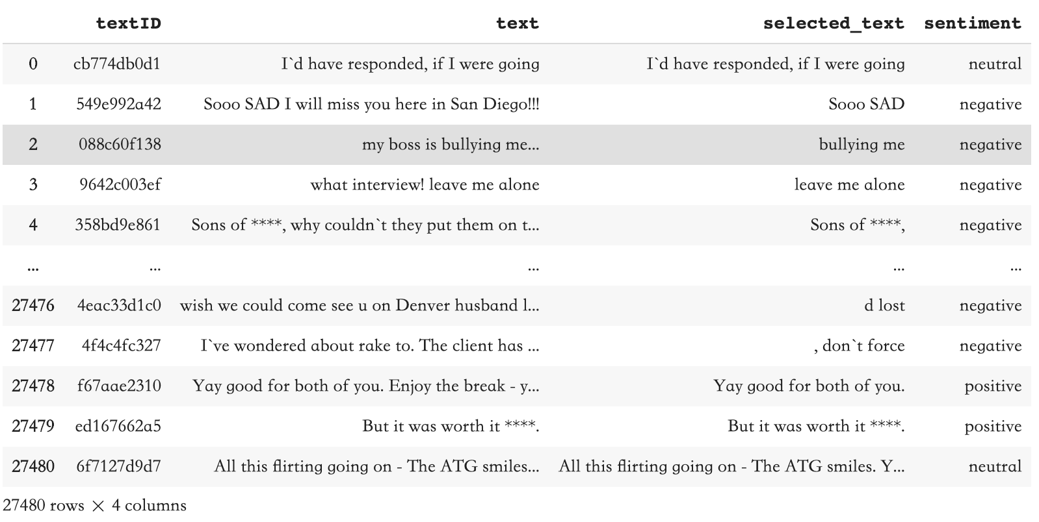
Data Description
a dataset of tweets
textID - unique ID for each piece of text
text - the text of the tweet
sentiment - the general sentiment of the tweet, including 3 types: neutral, negative and positive
selected_text - a subtext of text that supports the tweet's sentiment
Notes:
The dataset consists of 27,481 rows and 4 columns.
textID is the unique ID for each piece of text
text is the text of the tweet
Sentiment is the general sentiment of the tweet, including 3 types: neutral, negative and positive
selected_text is a subtext of text that supports the tweet's sentiment
Our goal is to extract key text from text as selected-text that can express its sentiment
In this project, we removed the missing values, and divided the original training data into two datasets, in the ratio of 8:2 as the new training data and the new test data separately.

Slide 8
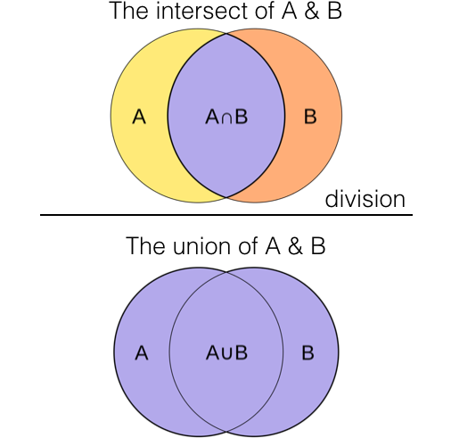
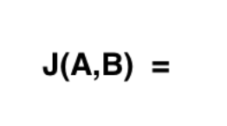
Evaluation index
Jaccard Similarity
A formula measuring how much overlap there is
between A and B.
Notes:
In our subsequent experiments, the evaluation index is Jaccard similarity. It is basically a formula for measuring how much overlap there is between A and B. It can be easily visualized using venn diagrams as shown on the right hand side. We’ll call it Jaccard score.
In our model evaluation, we calculate the Jaccard similarity score between prediction and ground truth. The higher the score, the higher the similarity, the more accurate our model predicts.

Slide 9
3. Exploratory Data Analysis (EDA)
Notes:
Next, I’ll talk about Exploratory Data Analysis.

Slide 10
Exploratory Data Analysis (EDA)
Proportions of three sentiments in the dataset
Apply Jaccard scores to check similarity
Find most common words
Notes:
In the exploration of data, we make sure that there is no missing values, and count the numbers of tweets posted that imply different sentiments. Based on the jaccard scores for each target tweets, we check for the similarity between selected and the original texts. We also find the most common words in the tweets.

Slide 11
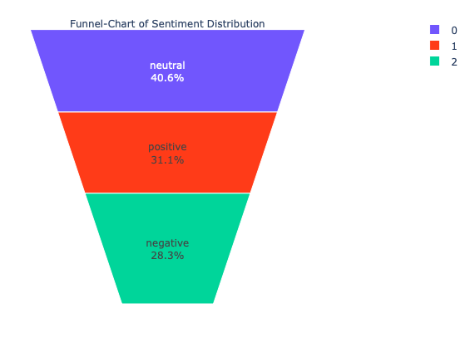
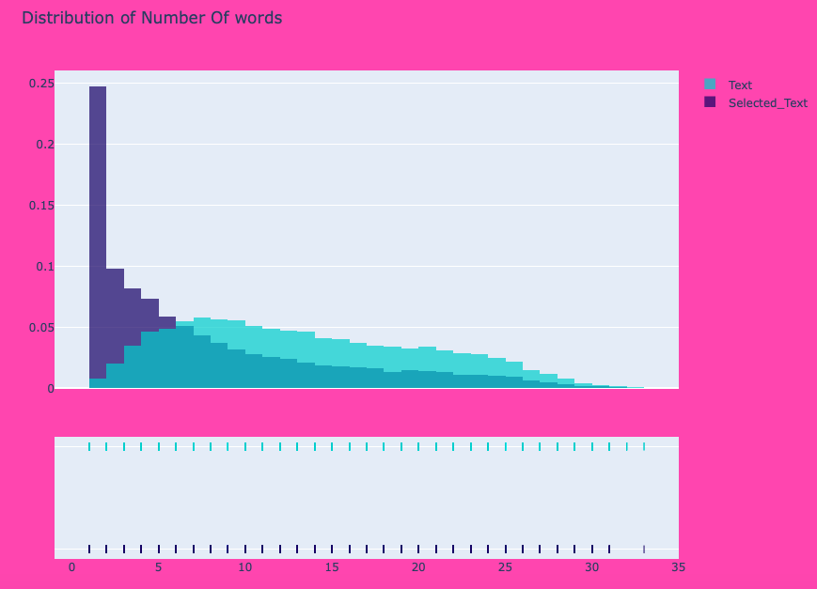
EDA - Sentiment Distribution
Notes:
So first, it's clear to see from this funnel chart of sentiment distribution, neutral tweets takes up the most position.
In addition, we explored the distribution of meta-features. The distribution of the number of words includes both words counted from the selected text and the original text. The histogram is right-skewed, meaning that most tweets have less than 25 words.

Slide 12
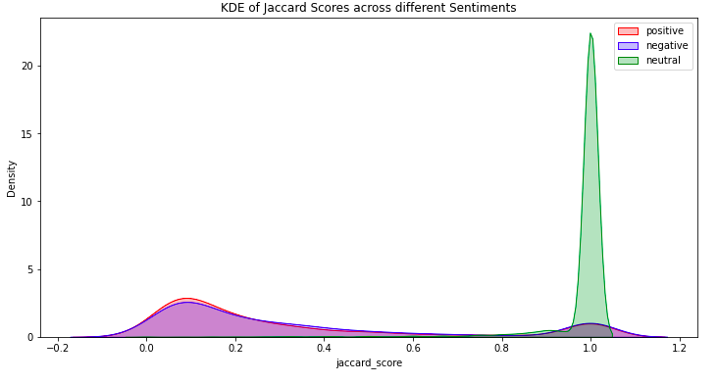
EDA - Similarity
Neutral sentiment concentrate in one region around the peak with score of 1.0.
Positive tweets and negative tweets have similar distributions, their patternings overlap a lot.
Notes:
To compare the Jaccard scores for these three sentiments together, we contribute the kernel distribution of Jaccard scores across all three sentiments.
This plot presents two obvious trends. Neutral tweets concentrate in one region around the peak with a score of about 1.0. Positive tweets and negative tweets have similar distributions, their patternings overlap a lot, concentrate in two regions around two peaks.
This implies the selected text is almost same as the original text when sentiment is neutral.

Slide 13
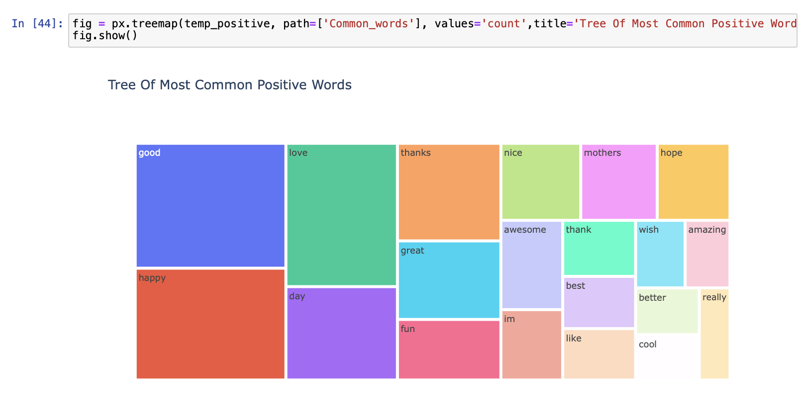
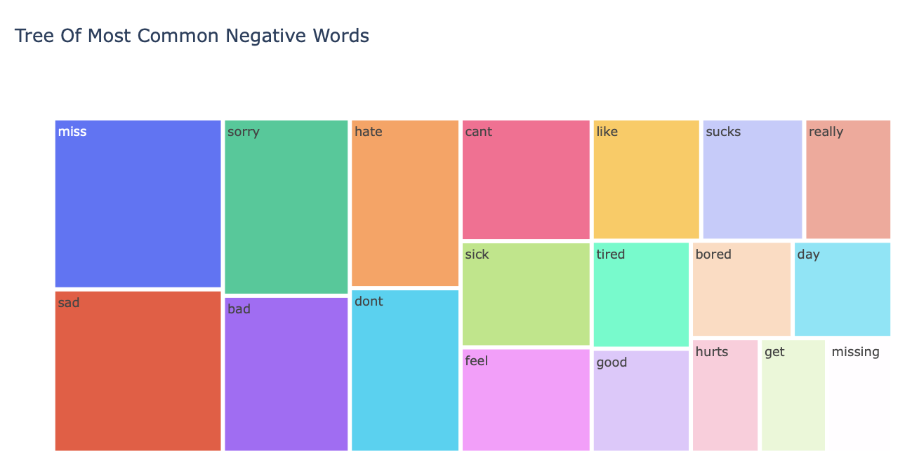
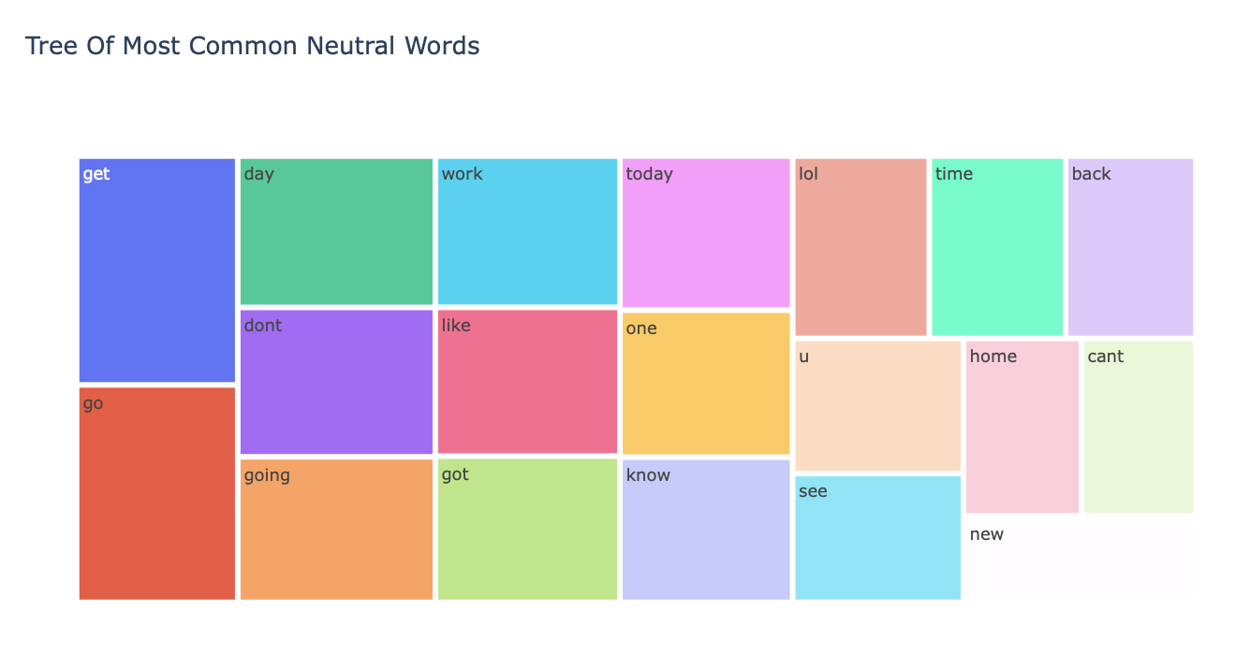
EDA - Most Common Words
Notes:
[click] These three tree graphs display the most common words in positive, negative and neutral sentiments.
[click] Positive words like 'good', 'happy', 'love', 'thanks' and 'great', appear frequently in positive tweets.
[click] Negative words such as 'miss', 'sorry', 'bad' and 'hate', strongly expressed unsatisfied negative sentiment in tweets posted.
[click] Other words in neutral sentiment actually do not express any special sentiments, like 'work', 'going' and 'get' etc.

Slide 14
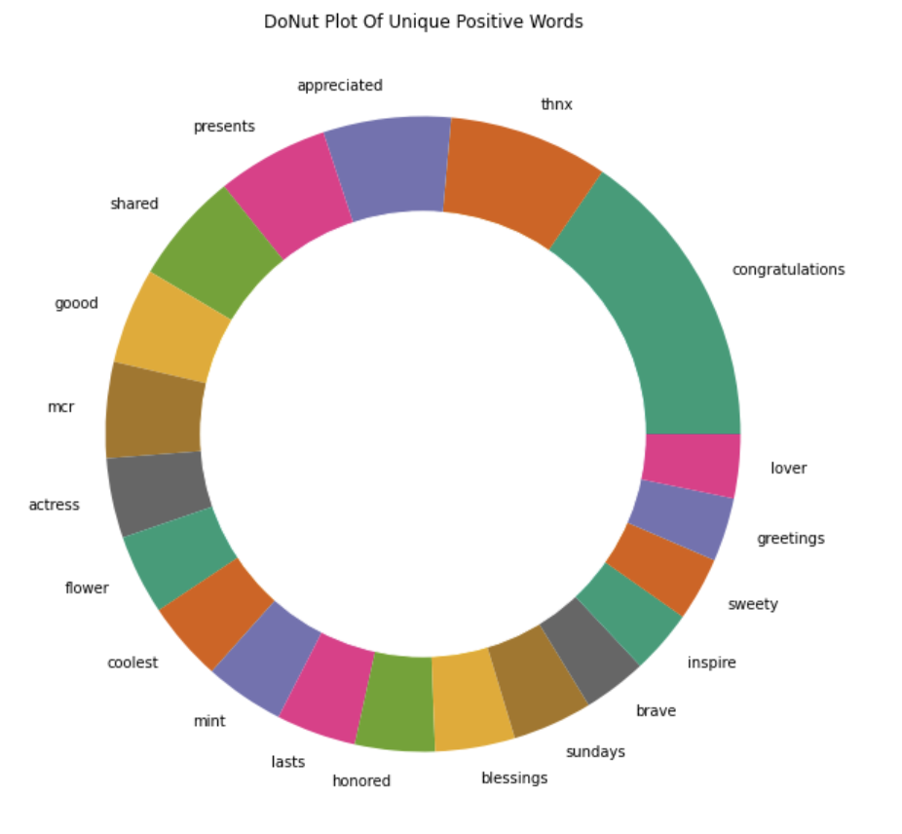
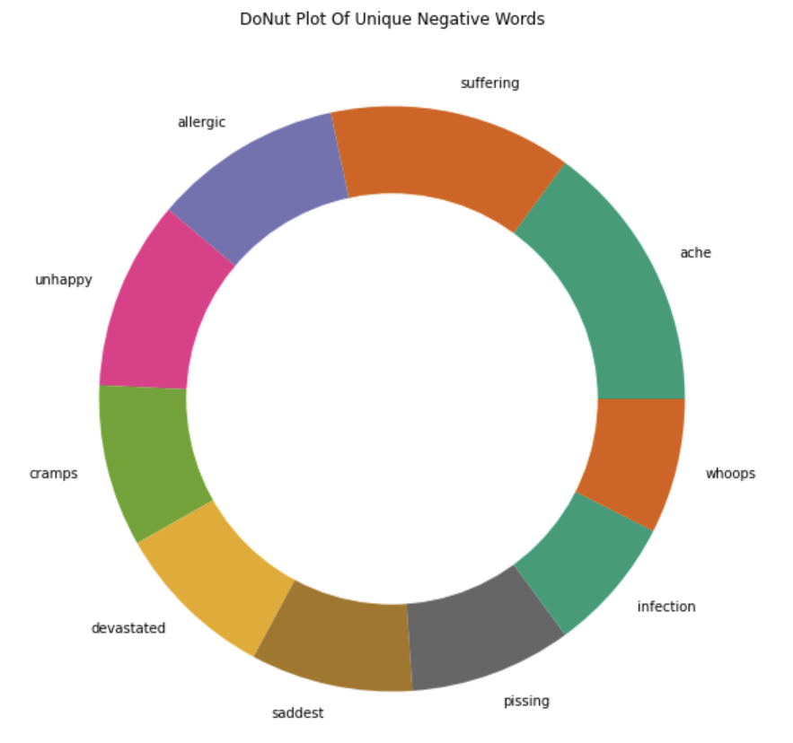
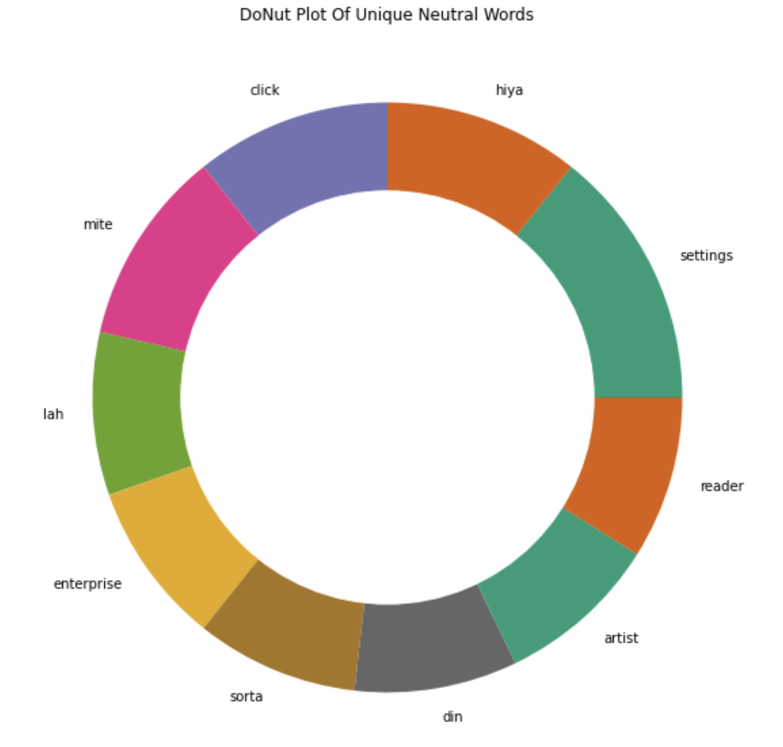
EDA - Most Common Unique Words
Notes:
There are variations of words, for example, people write “thanks” as “thnx” and they are considered as unique words.
These three DoNut plots represent unique words in the order of positive, negative and neutral sentiments, indicating that unique words play a significant role in determining the sentiments.

Slide 15
4. Methods & Models
nltk
SpaCy
RoBERTa
Notes:
Then let's talk about the methods and models we used.

Slide 16
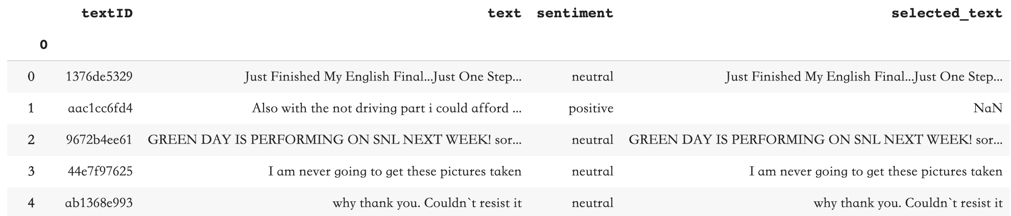
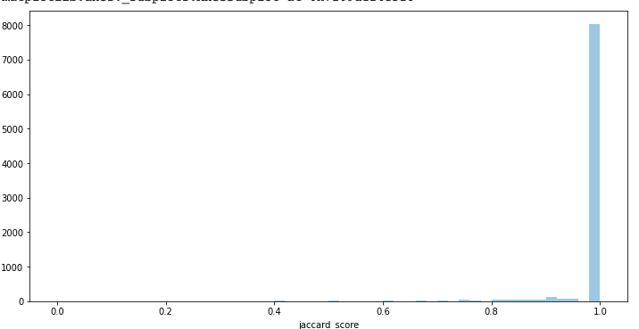
nltk
For neutral tweets
Neutral Jaccard score
Keep all the words
on neutral tweets
Notes:
After EDA, we notice that in training dataset, the average Jaccard score of neutral sentiment between text and selected text is around 97.6%, which implies the selected text are almost same as the original text. So we consider to keep all the words as the selected text extracted in neutral tweets.(右边是变化的过程)

Slide 17
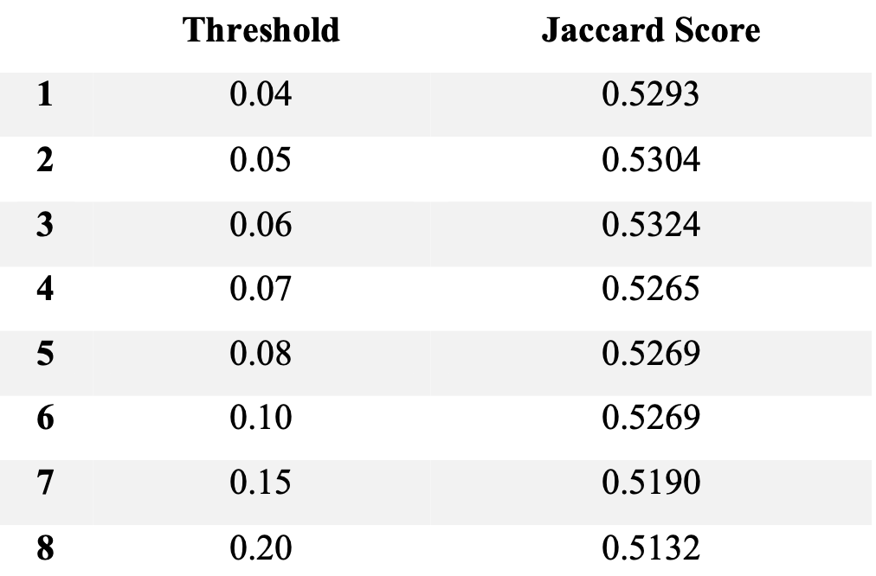
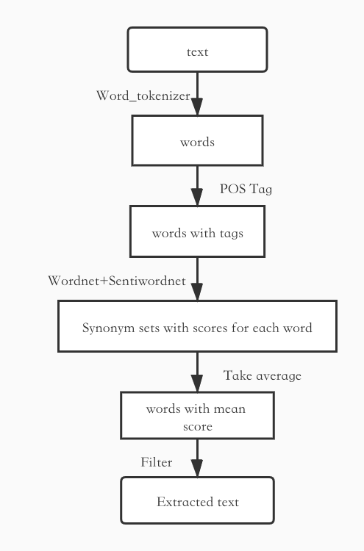
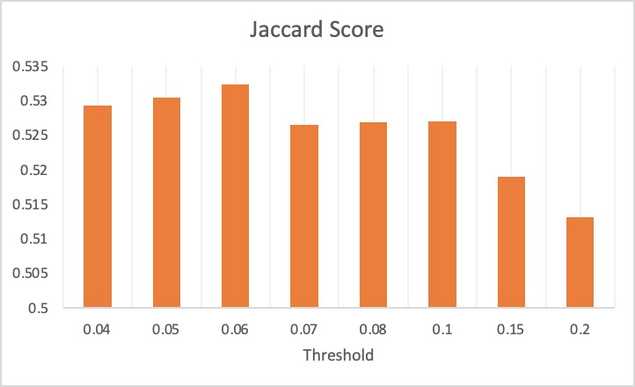
nltk
For pos & neg tweets
Final score:
52.6%
Notes:
For positive and negative tweets, We use nltk to do NLP.
Firstly, we tokenized the text, attached a part-of-speech tag to each word, converting the P.O.S tags to simple Wordnet tags.
According to the tag, we found the set of synonyms for each word in the nltk corpus, and calculated the sentiment scores individually in all synonym sets. After we got the average sentiment scores of all words in each text, we extracted the corresponding sentiment scores (pos or neg) against the sentiment of the text. At this point, we set a threshold to filter out words with scores less than it.
We chose 0.06, the threshold with the highest score on the training set to predict on test set, and the final Jaccard score was 52.6%.

Slide 18
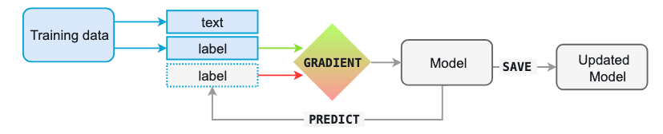
SpaCy
Named-Entity Recognition (NER)
Notes:
After consulting relevant information, we decided to use NER to solve this problem. In our project, we use spacy.
First, we converted the training data into the format required by SpaCy
Second, Creating an empty SpaCy NER model and trained it by adding our custom entities present in the training dataset.
Third, We give the model feedback on its prediction, in the form of an error gradient of the loss function, which calculates the difference between the training example and the expected output.
Finally, saving the updated model.

Slide 19
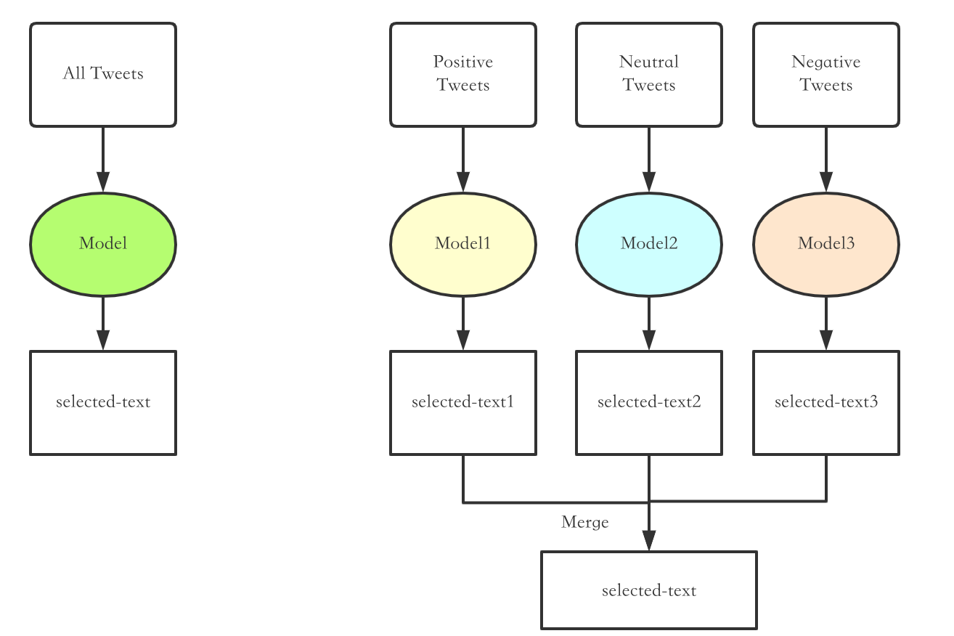
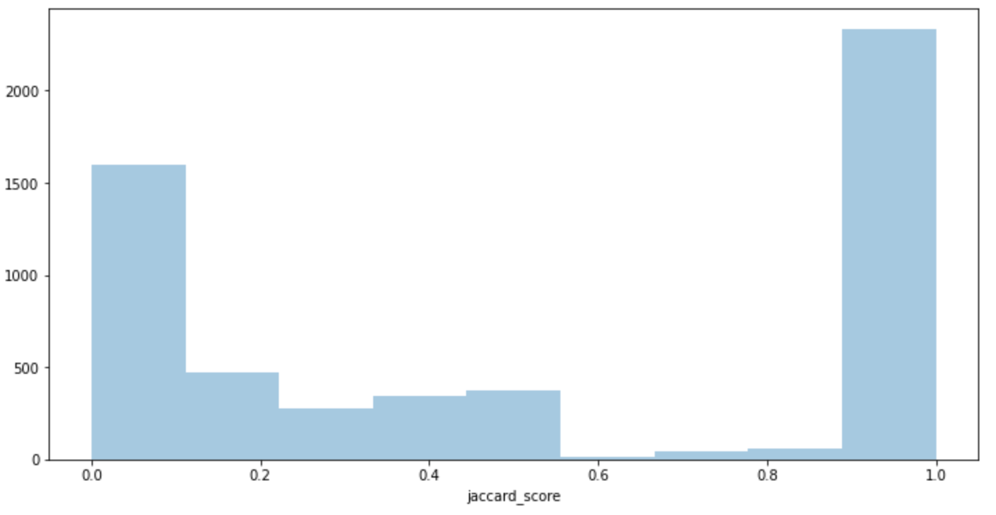
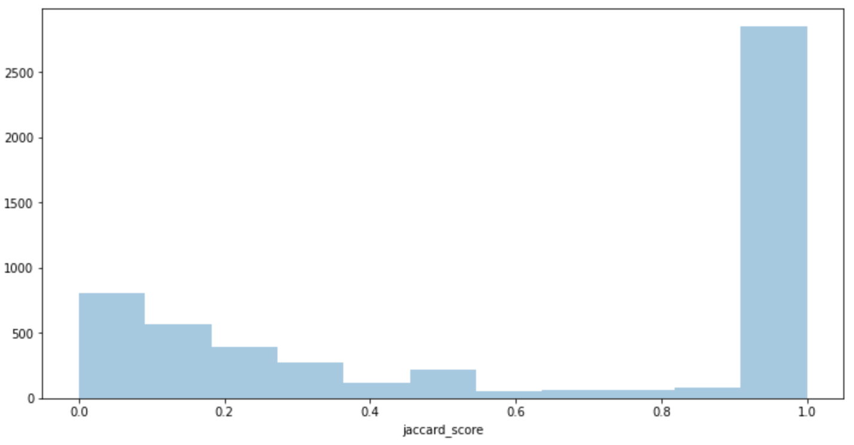
SpaCy
1 Model VS 3 Models
Final score:
57.8%
Final score:
63.2%
Notes:
Then, we select the model that performs best on the validation set to predict the testing set. The Jaccard score is 57.8%, which is higher than nltk.
Next, we consider creating models separately on tweet text of each sentiment, the experimental result shows that this has a higher accuracy rate with a Jaccard score of 63.2%.

Slide 20
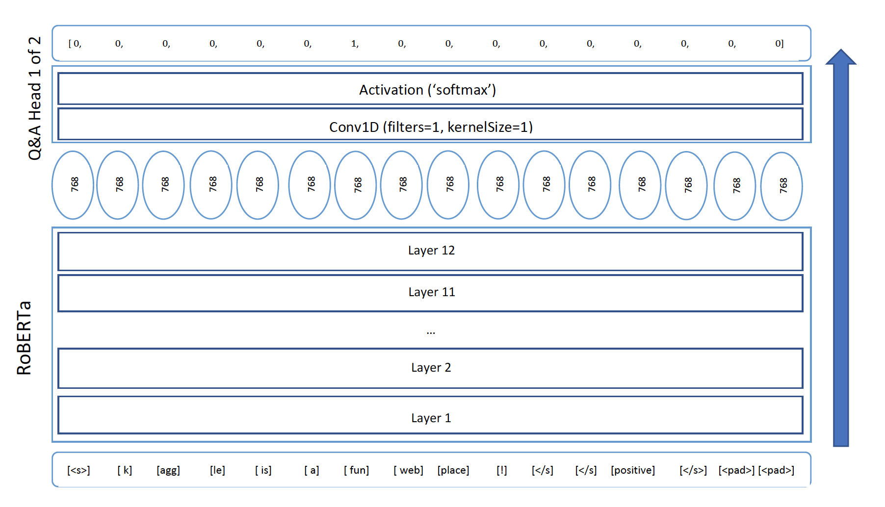
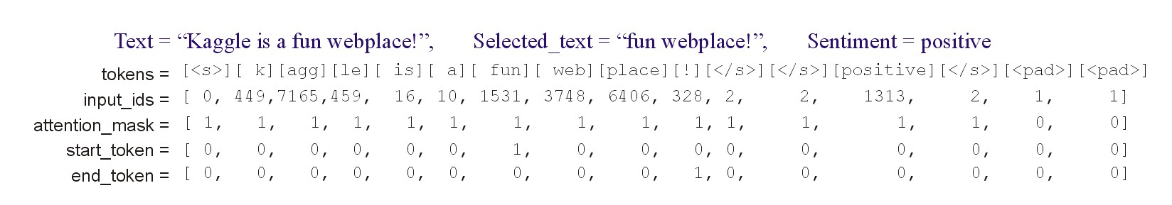
RoBERTa
Notes:
Finally, we use the Roberta Model in HuggingFace transformers.
All we gonna to do is converting data into the format we want. Like this (grph), we need five embeddings.
We input the data into the RoBERTa model and apply a drop layer, a Convolutinal layer, a Flatten layer and a softmax layer to get the corresponding probability. After data post-processing, the predicted answer can be obtained.

Slide 21
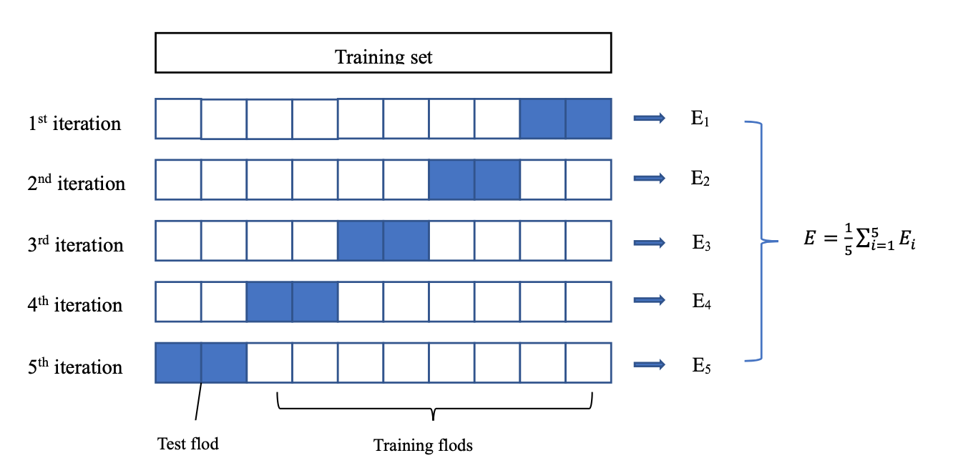
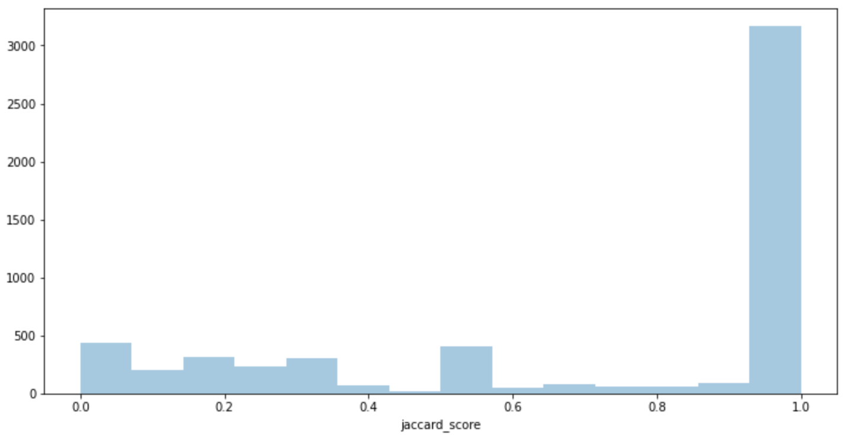
RoBERTa
Final score:
70.9%
Notes:
We did the five-fold cross-validation on training set. Each fold, we set checkpoints to find the best model weights and save it.The final five-fold cross-validation average Jaccard score is 70.5%.Then we load the best model to predict the testing set and the Jaccard score on the testing set is around 71%.

Slide 22
5. Conclusion & Future Works
Notes:
Here are the conclusions.

Slide 23
Conclusion
Extracting some words or phrases from sentences to reflect their emotions (neutral, positive or negative) is needed. In this project, we used a variety of methods to train our data and predict the word or phrase from the tweet that exemplifies the provided sentiment
 | nltk | SpaCy 1 | SpaCy 3 | RoBERTa (best result)
Jaccard Score | 52.6% | 57.8% | 63.2% | 70.9%
Notes:
Extracting some words or phrases from sentences to reflect their emotions (neutral, positive or negative) is needed. In this project, we used a variety of models to train our data and predict the word or phrase from the tweet that exemplifies the provided sentiment, including the nltk, SpaCy and RoBERTa. We found that RoBERTa achieved the best results rather than other results.

Slide 24
Future Works
Improve nltk
Adjust parameters for RoBERTa
Notes:
For future work, the result of prediction based on nltk was not very good, and the words filtered by the threshold were not continuous, which would cause the extracted text to be inconsistent. So we need to adjust the algorithm to make the sentence continuous.
The parameters of the pre-trained RoBERTa model are a lot and complex, and we are not very good at tuning parameters. We still need to continue to learn and be familiar with BERT.

Slide 25
Thank you!
Notes:
That's it. Thank you for listening.

